Slide 1

moose for dcs world ZONE CAPTURE coalition

Slide 2
what is zone capture coalition?
Take action on zone occupation of a coalition

Slide 3

ZONE_CAPTURE_COALITION
ZONE WITH EVENTS
Guarded: The owning coalition is guarding the zone.
Attacked: More coalitions in the zone. The owning coalition is attacked.
Empty: No coalition in the zone. The owning coalition is still owning the zone.
Captured: Transition to new coalition owning the zone.
GUARDED
ATTACKED
EMPTY
CAPTURED

Slide 4

zone capturing process
EVENT
STATE
ENTRY/EXIT
Guarded
Guard
Attack
Attacked
Empty
Empty
Capture
Captured
The zone will automatically monitor the coalition presence and will automatically fire events and generate state transitions.
A zone can be Guarded or Empty at the start, and is given an owning coalition.
Each change in the zone occupation generates an Event. Possible events are Attack, Guard, Empty, Capture.
Each Event generates a state transition, which will lead to the zone being Guarded, Attacked, Empty or Captured.
These state and event transitions can be captured in your code and do “stuff” at the moment of the transition.
ANY ACTION IS POSSIBLE!

Slide 5

“script it”
ZONE_CAPTURE_COALITION
:New() needs a ZONE object. For the moment, only ZONE classes can be used. (ZONE_POLYGON will be later usable).
:New() is given the initial owning coalition:
coalition.side.BLUE
coalition.side.RED
coalition.side.NEUTRAL is not possible.
The ZONE_CAPTURE_COALITION object must not be nil(led)/deleted in terms for it to continue working.

Slide 6
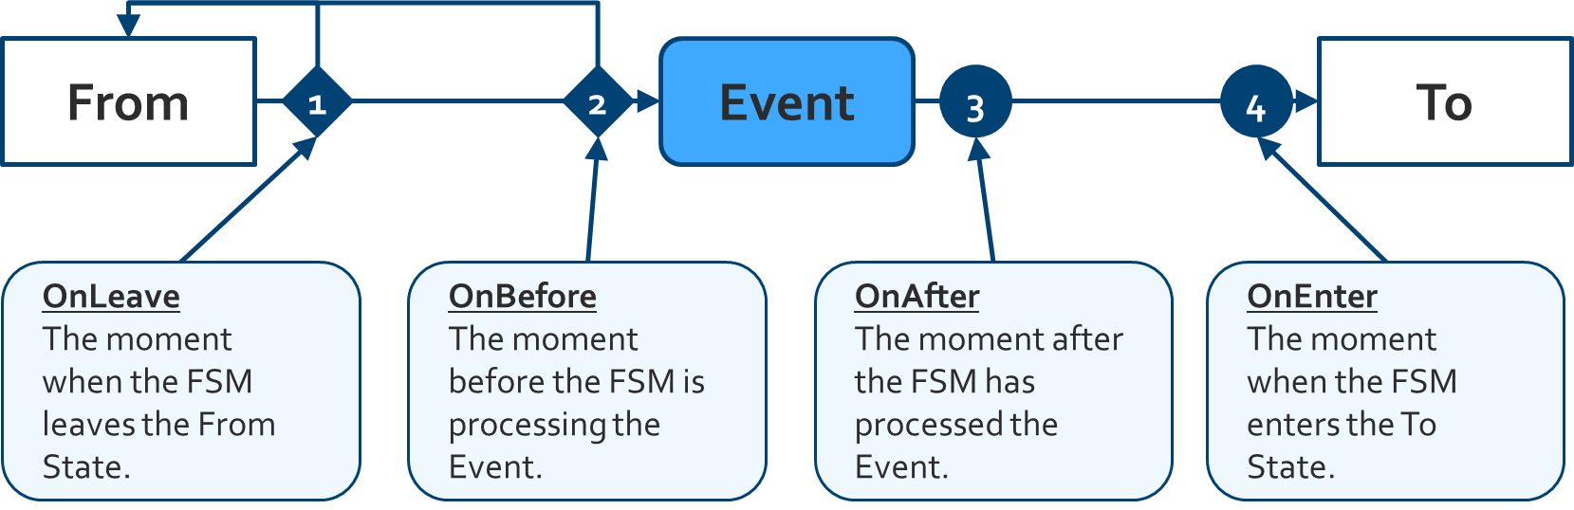
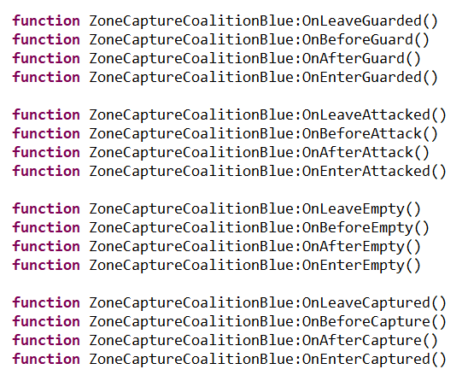
“script it”
Create functions to customize the zone occupation using state and event handlers.
State Handlers capture the moment:
On Leave from the old state. Return false to cancel the transition.
On Enter to the new state.
Event Handlers capture the moment:
On Before the event is triggered. Return false to cancel the transition.
On After the event is triggered.
STATE HANDLERS
EVENT HANDLERS

Slide 7
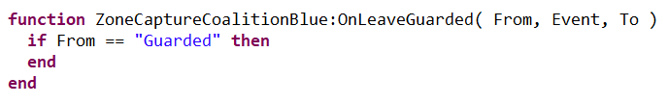
“script it”
Create functions to customize the zone occupation using state and event handlers.
Each handler can receive optionally 3 parameters:
From: A string containing the From State.
Event: A string containing the Event.
To: A string containing the To State.
The mission designer can use these values to alter the logic.
STATE and EVENT parameters
USAGE

Slide 8
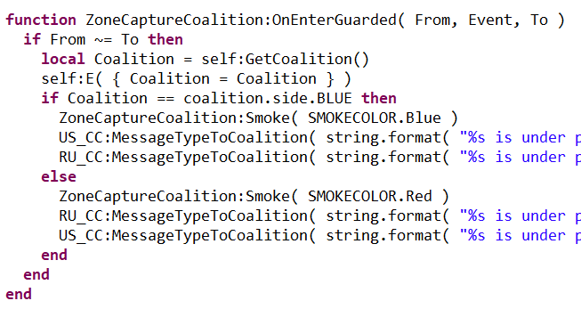
“script it”
Example of a State Handler
This handler manages the moment when the FSM enters the State Guarded.
The 3 parameters are given: From, Event, To.
When the From state is not equal to the To state (so, when the FSM does not transition from Guarded to Guarded), then execute the code block.
The code block will check the owning coalition , using self:GetCoalition(), and depending on ownership, smoke the zone either red or blue and send messages to each coalition.

